Slide 1
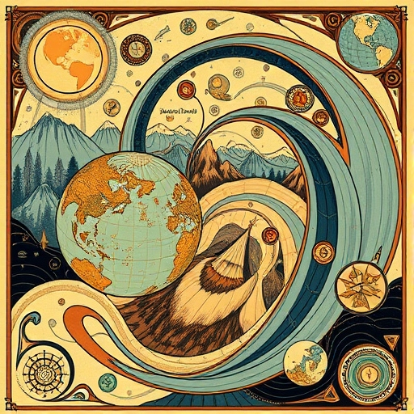
Welcome to GEOG 463/563!
Analytical Workflows for Earth Systems Science

Slide 2
Instructors
Zechariah Meunier, PhD
Research Associate, CEOAS
James Watson, PhD
Associate Professor, CEOAS
Studies how to measure dynamics (i.e., changing conditions) in coastal ecosystems, especially due to climate change and anthropogenic impacts
Postdoc work on scientific machine learning and coral reefs
PhD work on community structure and dynamics in rocky intertidal habitats
BA work on plant ecology and conservation in lakeshore dunes
Studies complex adaptive systems, consciousness in sports teams, larval dispersal, ecological regime shifts, fisheries conflict, offshore wind farms, and many more topics
Leads the Socio-Environmental Analysis (SEA) Lab at OSU

Slide 3
Introductions
Preferred name
Pronouns
Major
What did you do over spring break?

Slide 4
What do you hope to gain from this course?

Slide 5
Week 1 To-Dos
Create a GitHub account by Thursday, April 3
Join the course GitHub repository by Thursday, April 3
Generate ideas for group project by Thursday, April 3

